Slide 1
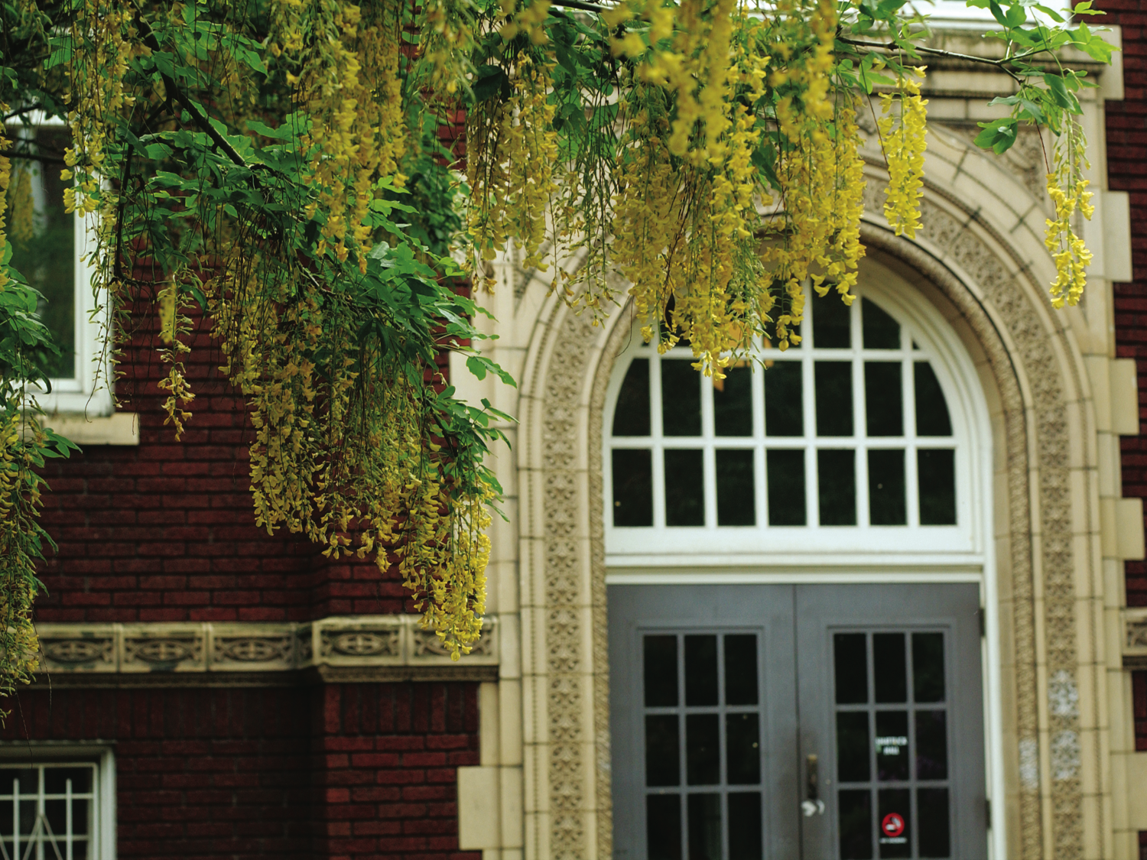
Oregon Demographic Trends and Census 2020
Salem City Club
March 22, 2019
Charles Rynerson
Census State Data Center Coordinator Population Research Center
College of Urban and Public Affairs

Slide 2
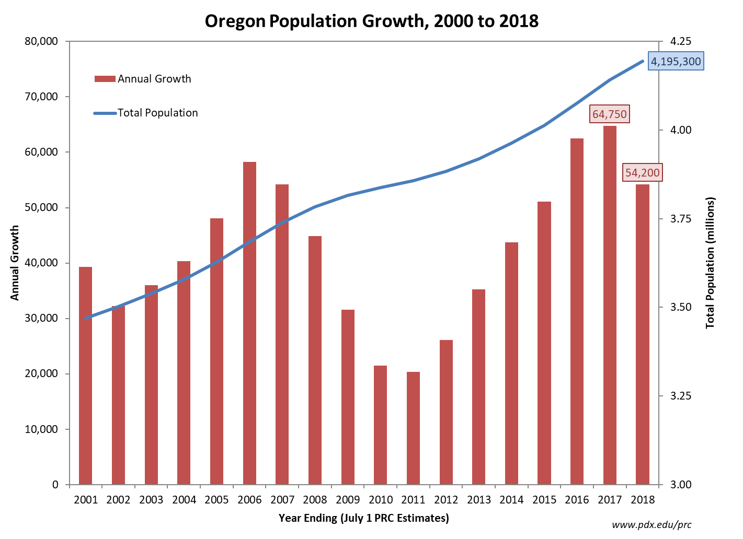
Notes:
Between 2000 and 2018 Oregon grew each year, gaining over 770,000 residents. Year-to-year growth during the 18 year period ranged from a low of about 20,000 to a high of nearly 65,000.

Slide 3
Oregon Population
4,195,300 in 2018
one year growth of 54,200 (1.3%)
over 770,000 added since 2000
population doubled since 1970
Average Annual Growth Rate
Period | Oregon | WA | CA | USA
1990-2000 | 1.9% | 1.9% | 1.3% | 1.2%
2000-2010 | 1.1% | 1.3% | 1.0% | 0.9%
2010-2018 | 1.1% | 1.3% | 0.8% | 0.7%
Notes:
1990 = 2,842,321
2000 = 3,421,399
2010 = 3,831,074
2018 = 4,195,300
1990-2000 Growth = 579,078 (20.4%)
2000-2010 Growth = 409,675 (12.0%)
California’s “slow” growth entails adding over 2.5 million residents between 4/1/2010 and 7/1/2018.

Slide 4
Components of Population Change
(“Demographic Balancing Equation”)
Population Change = Births – Deaths + In Migration – Out Migration
Simplified:
Population Change = Natural Increase + Net Migration
Notes:
Population change in a given area occurs due to four demographic events: people are born, people die, people move into the area, people move out of the area.

Slide 5
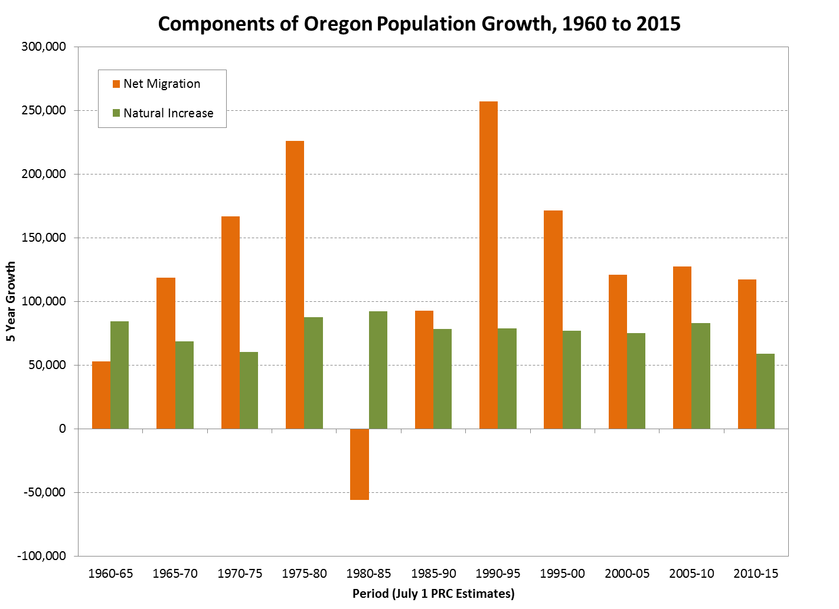
Notes:
Natural increase (births minus deaths) was low during the “baby bust” of the late 1960s and early 1970s, but it is plunging again due to low fertility rates and the aging population. The early 1980s recession prompted more people to move out of Oregon than into it.

Slide 6
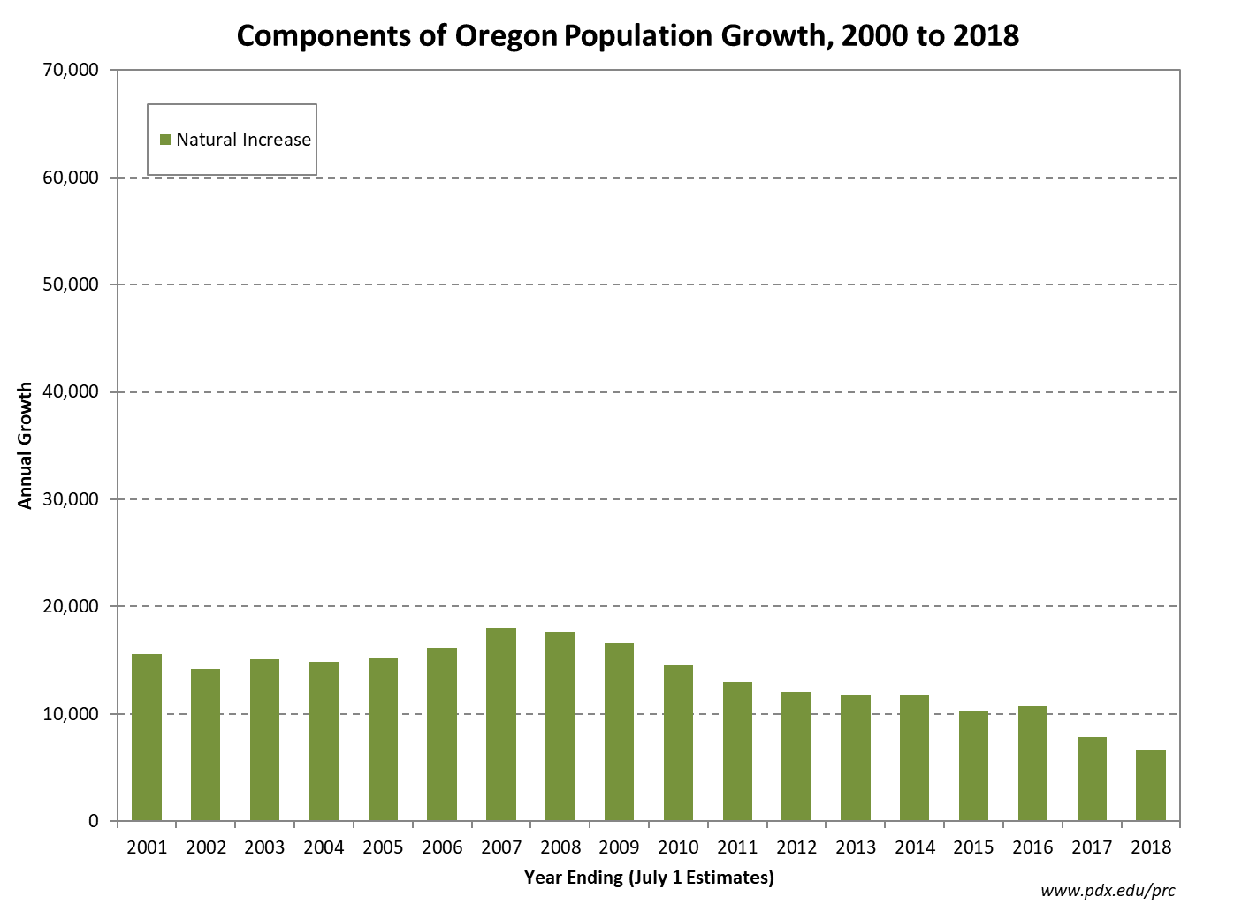
Notes:
Due to an aging population and declining birth rates, natural increase now contributes less to Oregon’s population growth than at any time since the 1930s. The number of births to Oregon residents from July 2017 to June 2018 was about 14 percent lower than its recent peak in 2007-08. The number of deaths continues to climb due to the growth in older population.

Slide 7
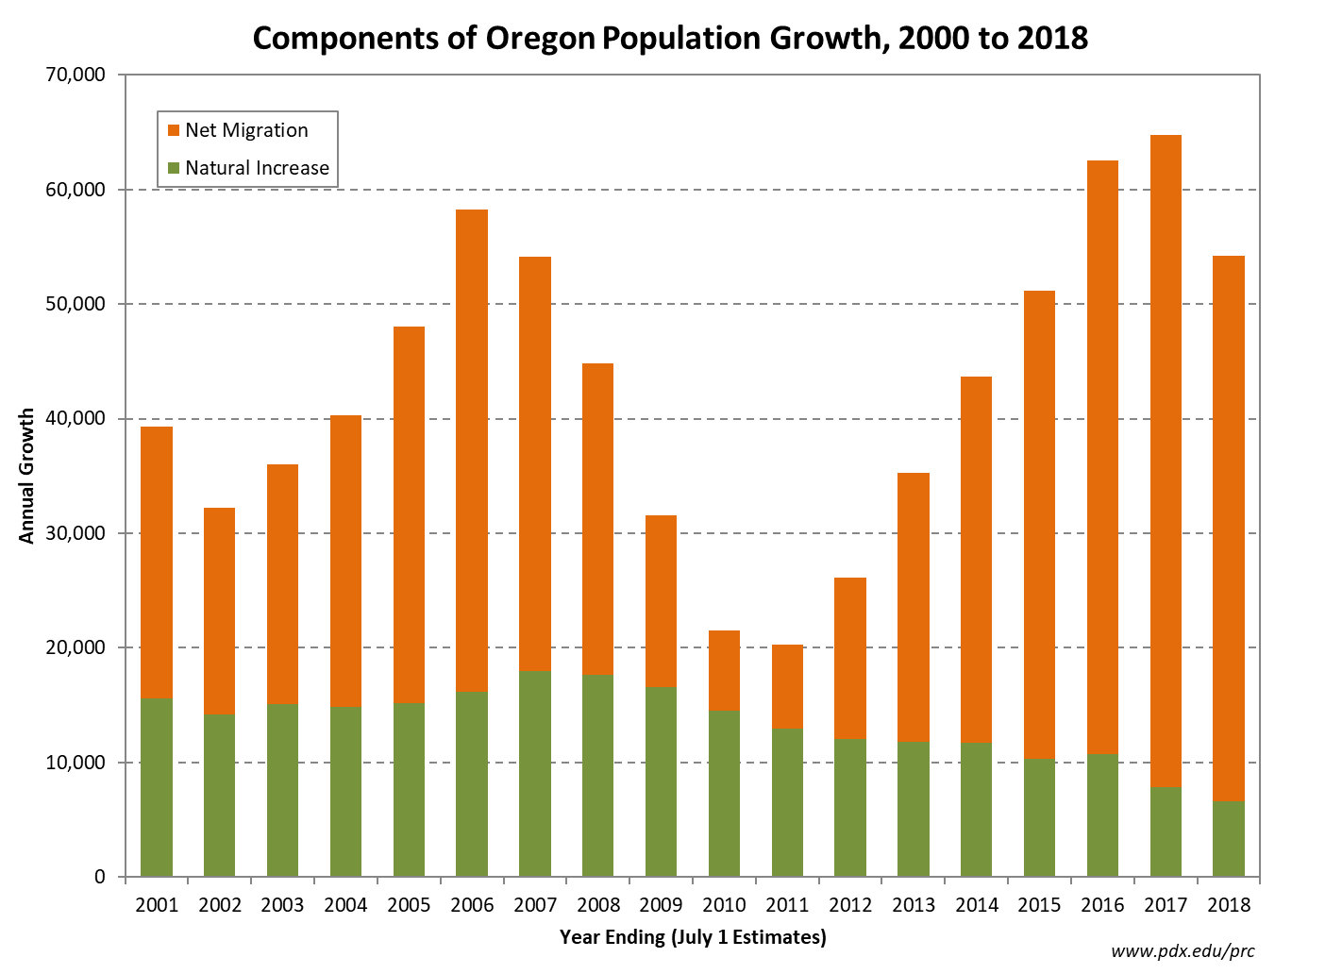
Notes:
Contrasting the slowdown in natural increase, net migration has accelerated, as the number of people moving to Oregon exceeded the number moving out by more than 40,000 for the fourth consecutive year. In the four years since 2014, net migration has resulted in about 200,000 additional Oregon residents, accounting for 85 percent of the state’s growth.

Slide 8
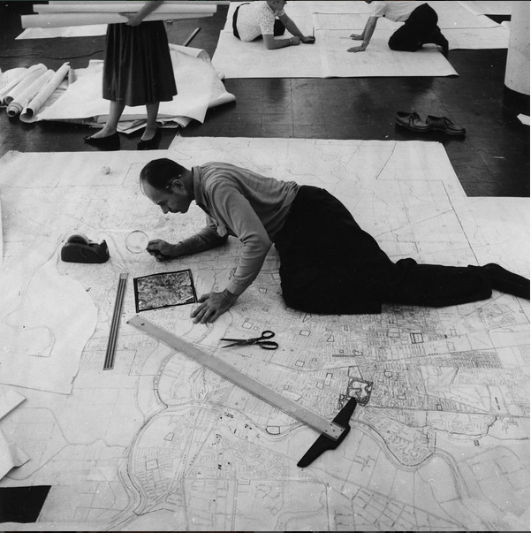




DECENNIAL CENSUS
Notes:
Census Bureau geographers checking the accuracy of census maps using aerial photos and magnifying glasses in the 1960s.

Slide 9
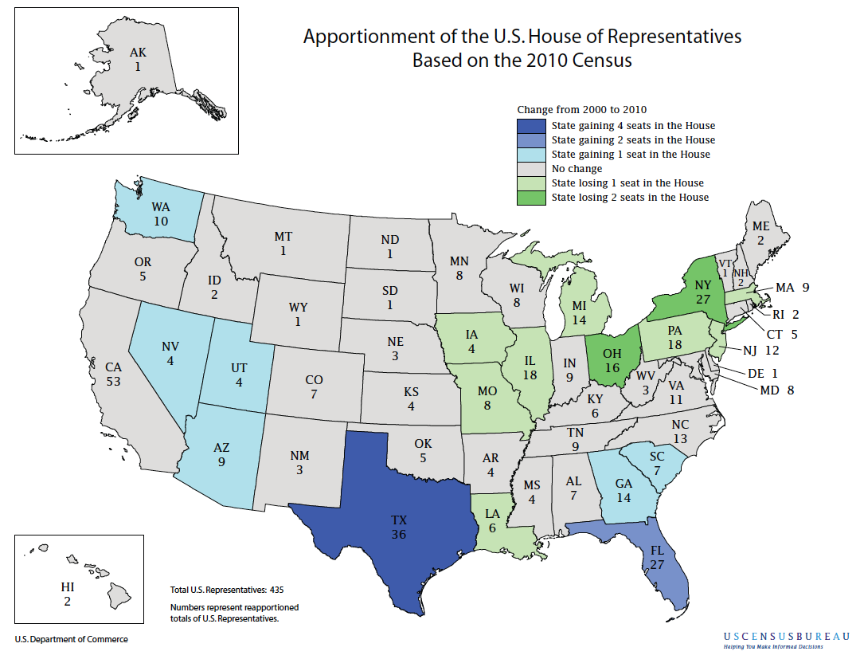
Notes:
The population of each state is required to be reported by December 31st each decade, following the April 1st Census. That determines the number of seats each state has in Congress. By March 31st of the following year, the population of each census block, total and 18+, by race and ethnicity, is reported so that states can begin redistricting.
“Representatives and direct Taxes shall be apportioned among the several States which may be included within this Union, according to their respective Numbers…”
- The Constitution of the United States, Article I, Section 2.

Slide 10
2018 Population per Seat in Congress
Oregon 839,060
Washington 745,692
California 751,419
United States 752,109
Notes:
Oregon fell short of getting a sixth seat in Congress after the 2010 Census. On the high end of 5 seats, it has more population per representative than the U.S. average.
Washington barely gained a 10th seat, so it is on the low end of 10 seats and each member of their delegation represents about 97,000 fewer people than each Oregon representative.
Oregon is not as underrepresented as Montana, the most populous state with only a single member of Congress.

Slide 11
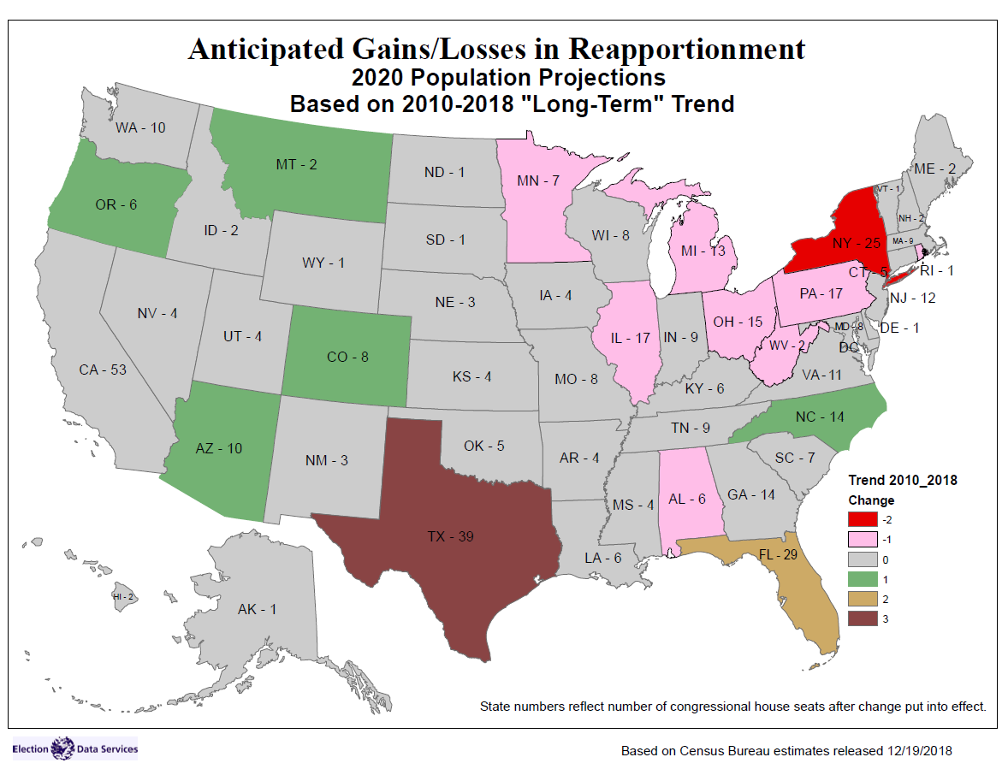
Notes:
This map shows the change in congressional representation based on 2020 Census results if each state continues to grow at the rate estimated by the Census Bureau between 2010 and 2018.

Slide 12
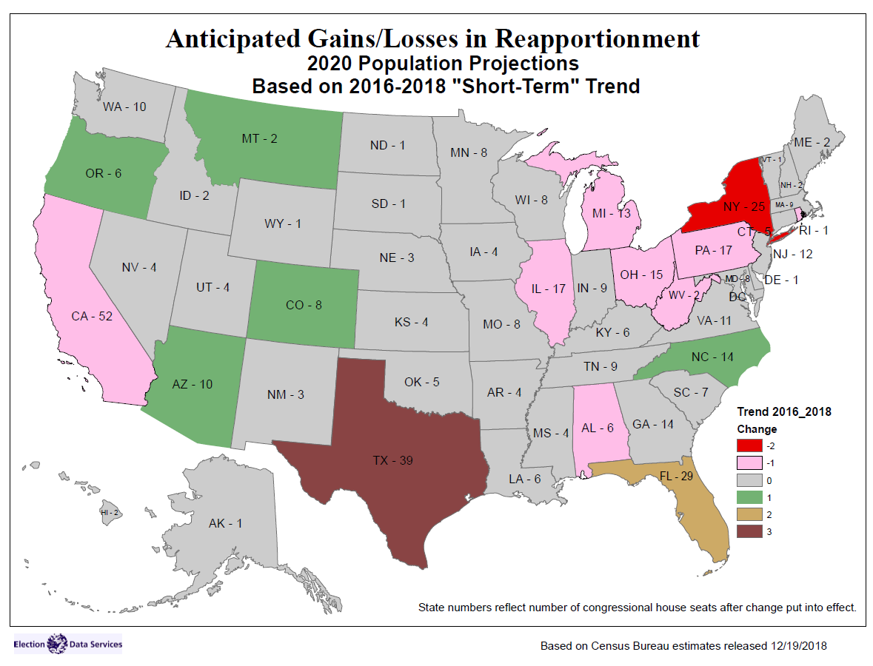
Notes:
Methodology for this projection differs from the previous slide, because it is an extrapolation based on growth rates in the most recent two years. The results are similar but notably MN hangs on to its seat and CA loses one.

Slide 13
Oregon April 2020 Population Forecast = 4,287,050*
4,287,050 ÷ 6 ≈ 714,500
*Interpolation of July 2019 and July 2020 population forecasts, Oregon Economic and Revenue Forecast, Office of Economic Analysis, March 2019.
Notes:
Based on the current forecast of Oregon’s population in 2020, there will be nearly 720,000 persons per Congressional District. (4,320,100 is a July 1 forecast).

Slide 14
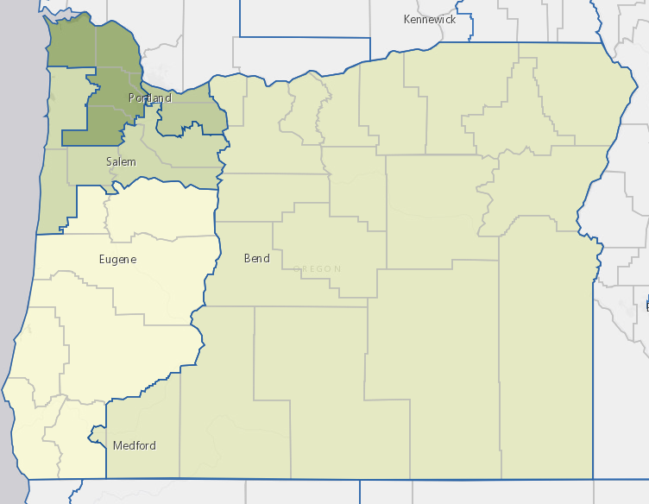
Population Estimates by Congressional District
2017 American Community Survey one year estimates
CD1: 844,175
CD3: 842,158
CD5: 831,703
CD2: 821,129
CD4: 803,611

Slide 15
2017 ORS 188.010
The Legislative Assembly or the Secretary of State, whichever is applicable, shall consider the following criteria when apportioning the state into congressional and legislative districts:
(1) Each district, as nearly as practicable, shall:
(a) Be contiguous;
(b) Be of equal population;
(c) Utilize existing geographic or political boundaries;
(d) Not divide communities of common interest; and
(e) Be connected by transportation links.
(2) No district shall be drawn for the purpose of favoring any political party, incumbent legislator or other person.
(3) No district shall be drawn for the purpose of diluting the voting strength of any language or ethnic minority group.
(4) Two state House of Representative districts shall be wholly included within a single state senatorial district.
Notes:
In Oregon, the state legislature is primarily responsible for drawing both congressional and state legislative district lines. If the legislature fails to approve a state legislative district map, the secretary of state must draw the boundaries. There is no similar backup provision for congressional redistricting.

Slide 16
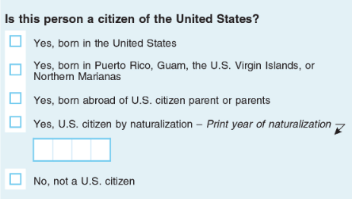
What is Changing for 2020?
Internet self-response
Clarification of opposite-sex or same-sex spouse or partner
Minor changes to race question (maintaining 1997 OMB standards)
Citizenship question? (New York v. United States Dep't of Commerce: Supreme Court April 23rd)
https://www2.census.gov/library/publications/decennial/2020/operations/planned-questions-2020-acs.pdf
Notes:
https://www2.census.gov/library/publications/decennial/2020/operations/planned-questions-2020-acs.pdf
A citizenship question was added at the request of DOJ, and is currently being litigated.
Same sex relationships were imputed based on the sex question in the 2010 Census. For 2020, specific check boxes have been added to the relationship question.
Changes including a new Middle Eastern and North African category and combining the race and ethnicity questions were recommended by a scientific advisory committee. However, OMB did not enact the changes, so the race and ethnicity questions will continue to follow the 1997 standards used in the 2000 and 2010 censuses. That is, separate questions for Hispanic/Latino/Spanish Origin and race. However, there are minor changes from 2010. Write-in boxes have been added for white and black persons to specify origins such as Irish, Jamaican, etc., similar to write-in boxes for the other race groups. The term “Negro” has been removed from the Black or African American group. Specific race check box categories and “other” examples for Asians and Pacific Islanders have been rearranged.
Among other uses, race data are required to:
• Establish and evaluate the guidelines for federal affirmative action plans under the Federal Equal Opportunity Recruitment Program.
• Monitor compliance with the Voting Rights Act.
• Monitor and enforce equal employment opportunities under the Civil Rights Act of 1964.
• Identify segments of the population who may not be getting needed medical services under the Public Health Service Act.

Slide 17
Area Census Offices (ACOs)
Area Census Office in Salem has opened, covering Oregon, Idaho, Hawaii
4760 Portland Road, Salem OR 97305
(503) 385-0611
July 2019: Two additional Area Census Offices open in Oregon, in Portland and Eugene.

Slide 18
Recruiting Census Workers
Spring 2019
Address Canvassing field staff (approx. 300 per ACO)
Spring 2019
Wave 2 ACO Management (approx. 10 per ACO)
Fall 2019
Non-Response Follow-Up field staff (approx. 500 per ACO)
Recruiting Information for All Positions
www.census.gov/2020jobs
www.usajobs.gov
1-800-992-3529 (Recruiting Hotline)

Slide 19
Other Census Bureau Staff in Oregon
Partnership Specialists (5 in Oregon as of March)
John Cummings covers Marion County
(971) 720-8641
john.w.cummings@2020census.gov
Data Dissemination Specialist
Heidi Crawford
(202) 774-4445
heidi.r.crawford@census.gov

Slide 20
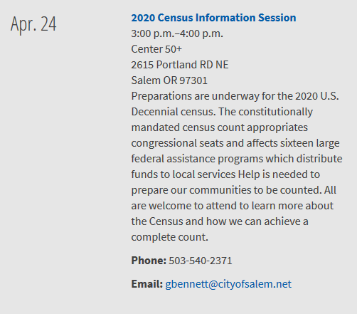
City of Salem

Slide 21
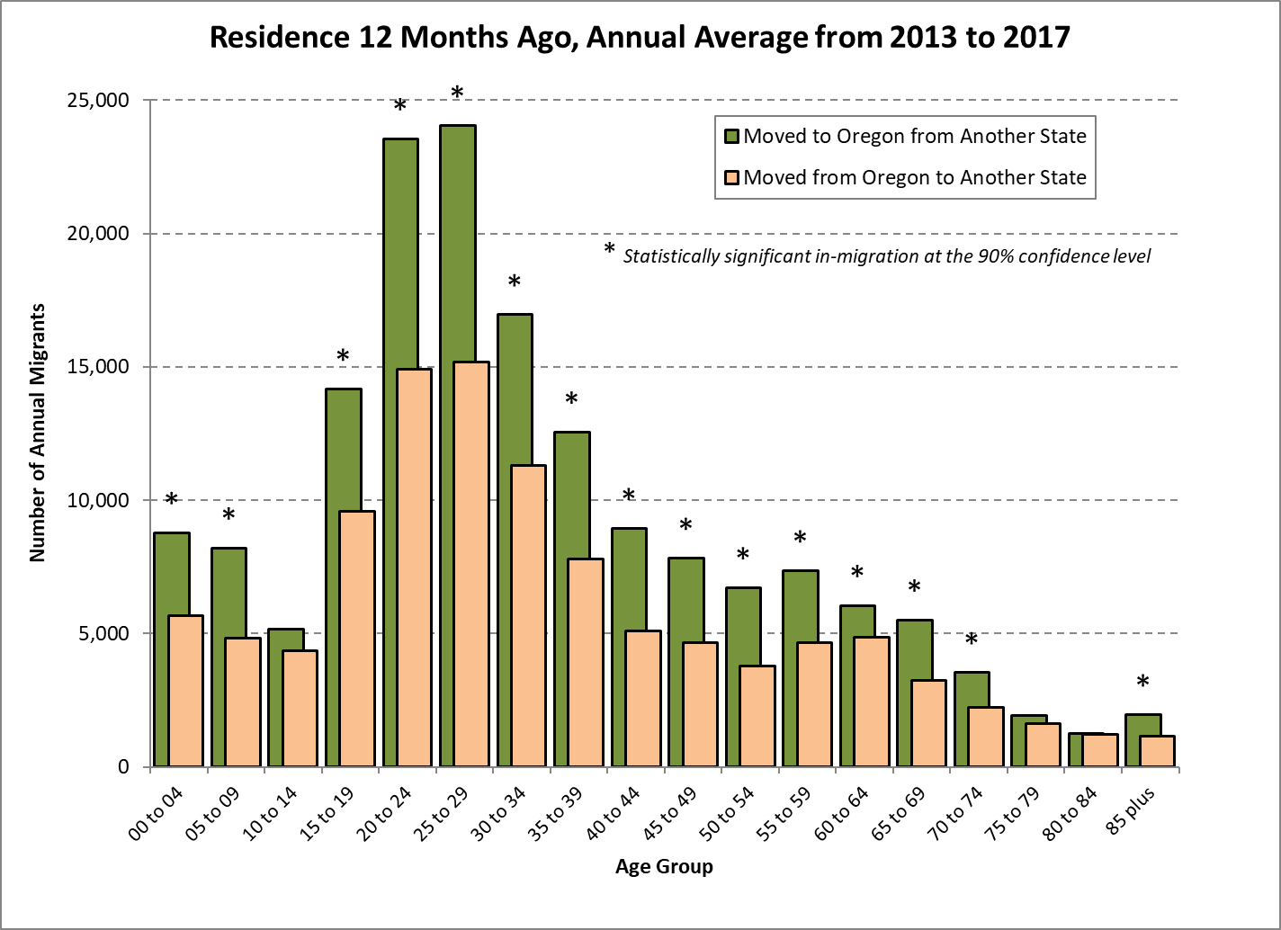
Source: U.S. Census Bureau, 2013-2017 American Community Survey 5 year public use microdata sample.
Notes:
This illustrates domestic interstate migration only, not including international migration.
Source: 2013-2017 ACS 5 year estimates, Public Use Microdata Sample.

Slide 22
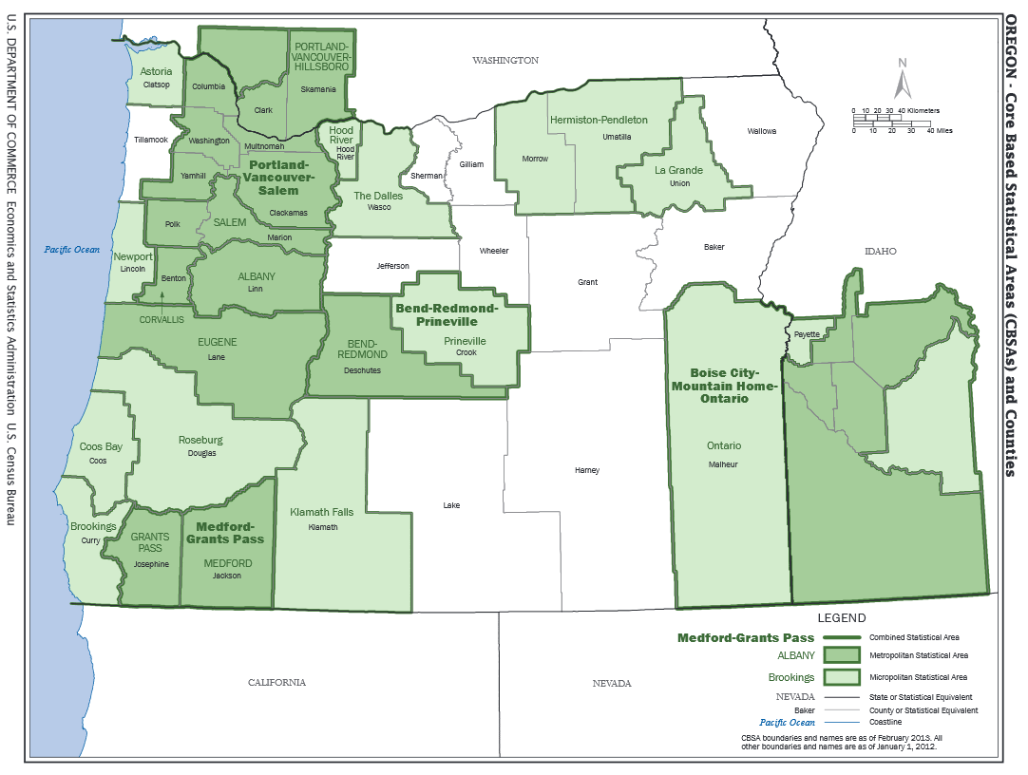
Notes:
There are several layers of what the federal government (OMB) calls “Core Based Statistical Areas” but the most important are Metropolitan Statistical Areas, which are counties or groups of counties with a core urban area of 50,000 or more population. Albany and Grants Pass attained Metropolitan status in 2013, based on the results of the 2010 Census. The City of Grants Pass has fewer than 50,000 residents but its contiguous urbanized area meets the threshold.
A total of 13 of Oregon’s 36 counties are in metropolitan statistical areas.

Slide 23
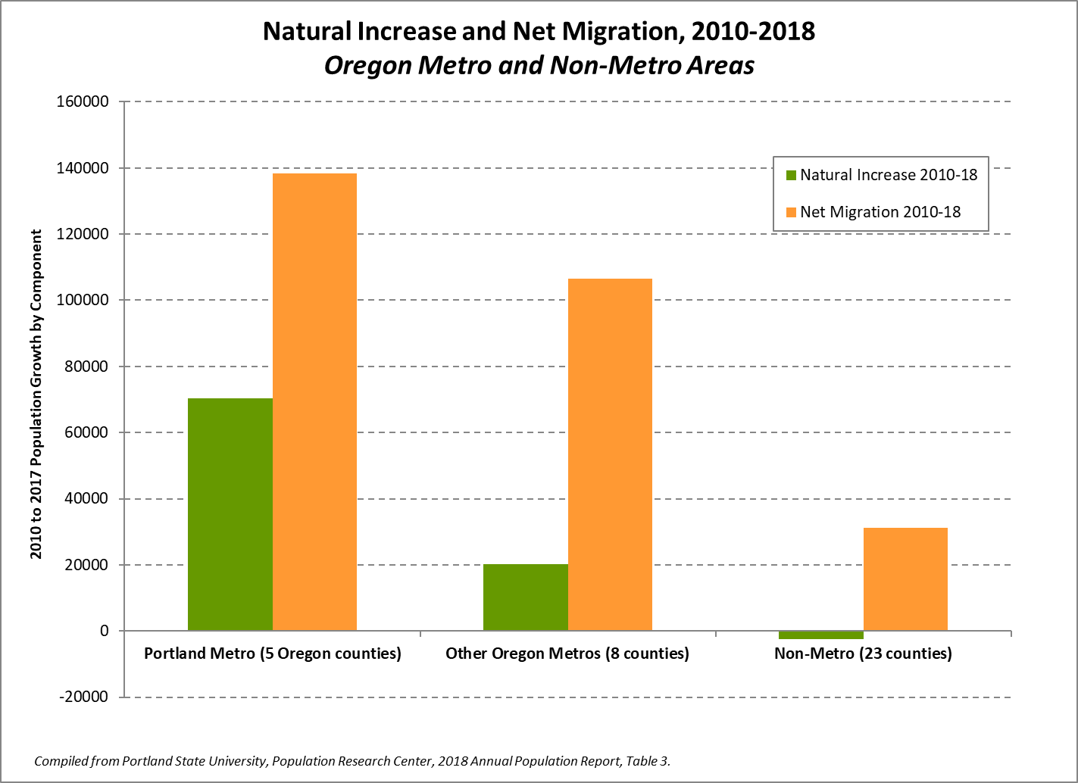
Notes:
The Oregon portion of the Portland-Vancouver-Hillsboro metro area is home to 48 percent of Oregon’s population. It accounted for half of the state’s growth due to net migration between the 2010 Census and our July 2018 population estimates, and four fifths of the state’s natural increase.
Other Oregon metros all had significant net growth due to net migration, but relatively little growth due to natural increase. Most of the natural increase shown for the eight metro counties outside of the Portland area is attributable to Marion County. In one metro county, Josephine, natural increase between 2010 and 2017 was negative, with more deaths than births.
The number of deaths to residents of Oregon’s 23 non-metro counties since 2010 is slightly greater than the number of births. Natural increase occurred in non-metro counties with relatively large Latino populations but was offset by decreases in other metro counties. Statewide, the white, non-Latino population grows only due to net migration, as natural increase for white, non-Latinos is negative.

Slide 24
Notes:
Residents relocating from California get a lot of attention in the media and in Oregon’s popular culture. While it is the top source of migrants to Oregon, only about a quarter of Oregon in-migrants are from California. Among drivers surrendering U.S. or Canadian licenses to the Oregon DMV, 31 percent were from California and 16 percent were from Washington. However, the share varies regionally within Oregon. Southwest Oregon (Coos, Curry, Douglas, Jackson, Josephine) and Deschutes get about one third of their new residents from California, while only 20 percent of Portland area in-migrants moved from California.

Slide 25
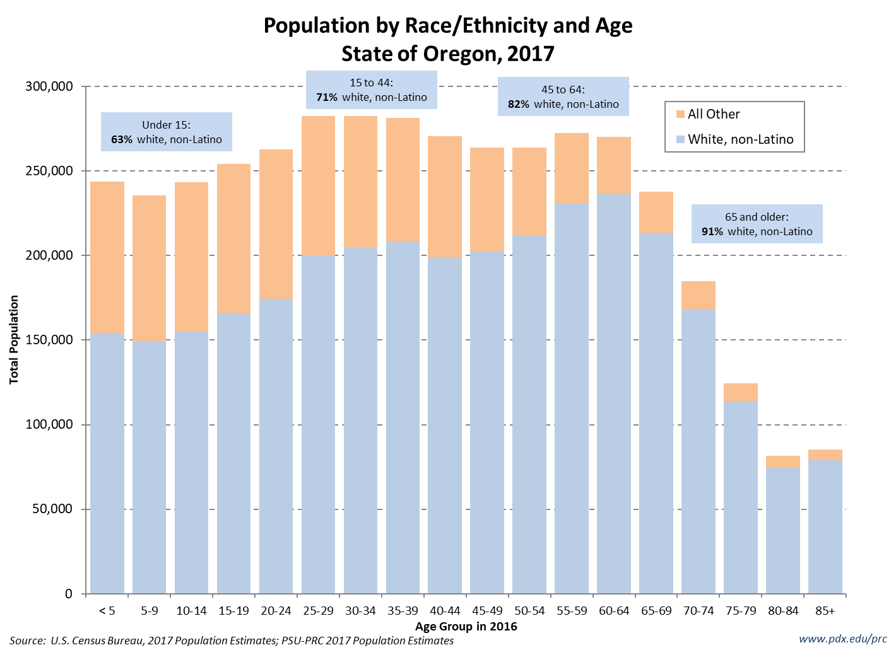

Slide 26
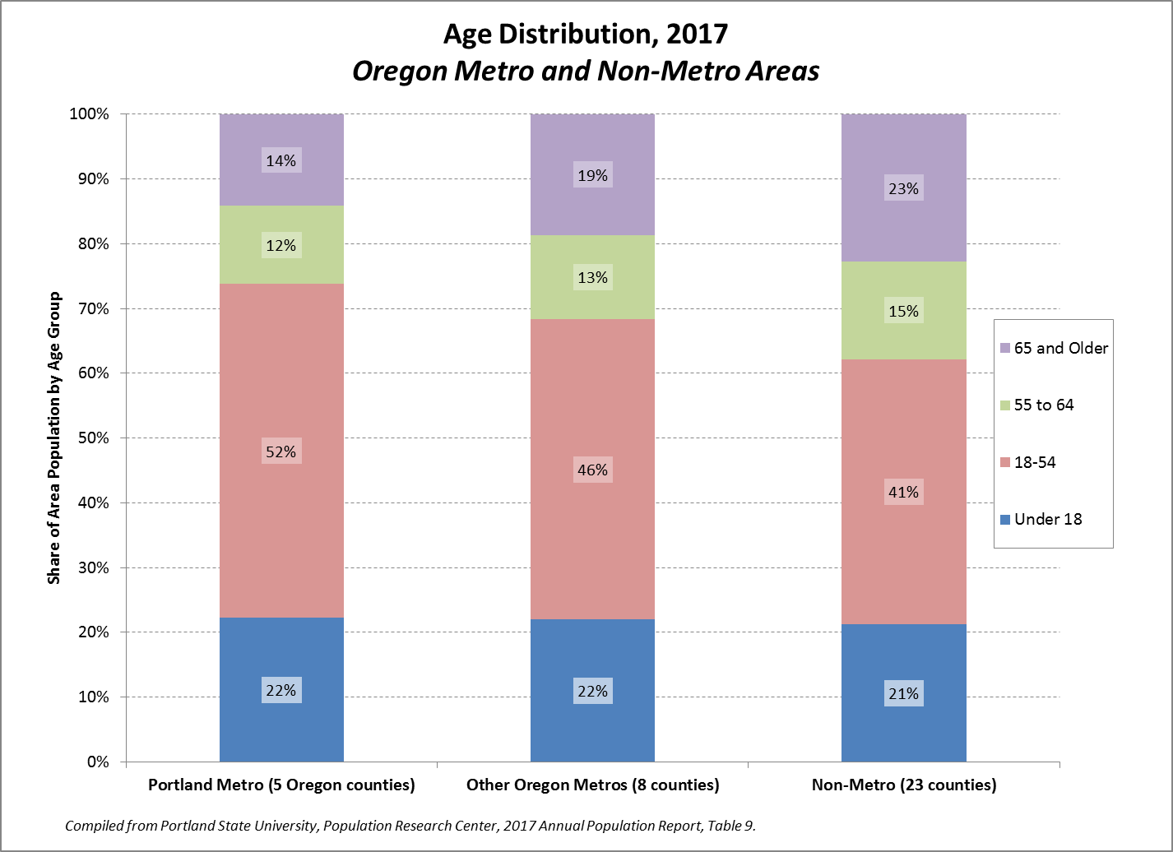

Slide 27
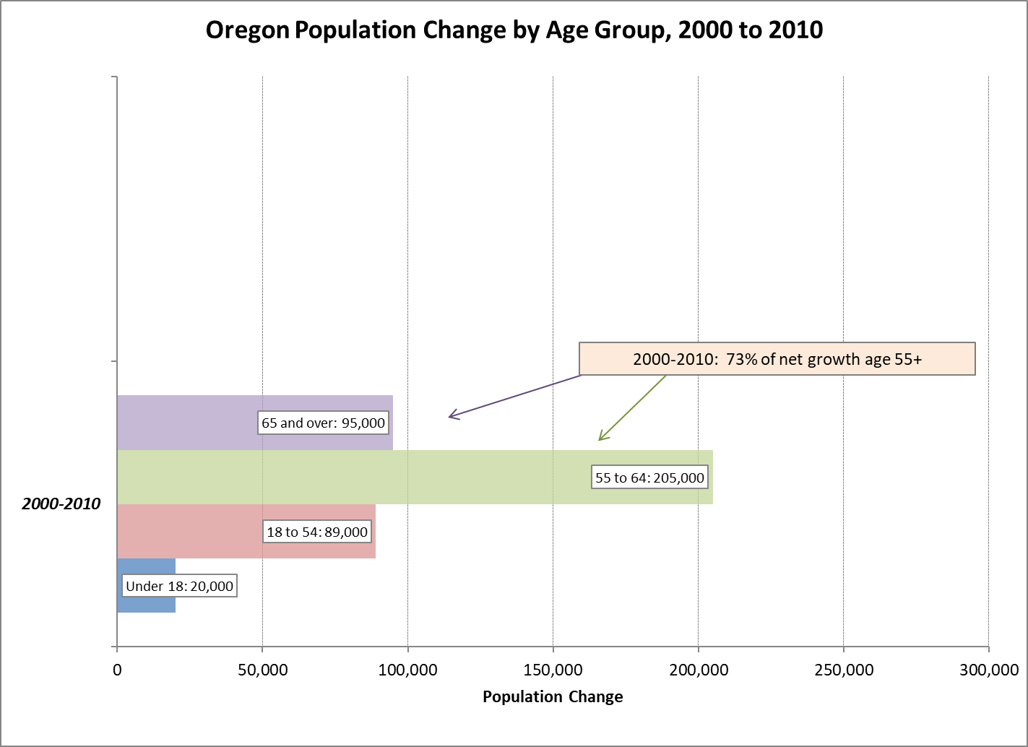
Source: U.S. Census Bureau, Decennial Census, 2000-2010.

Slide 28
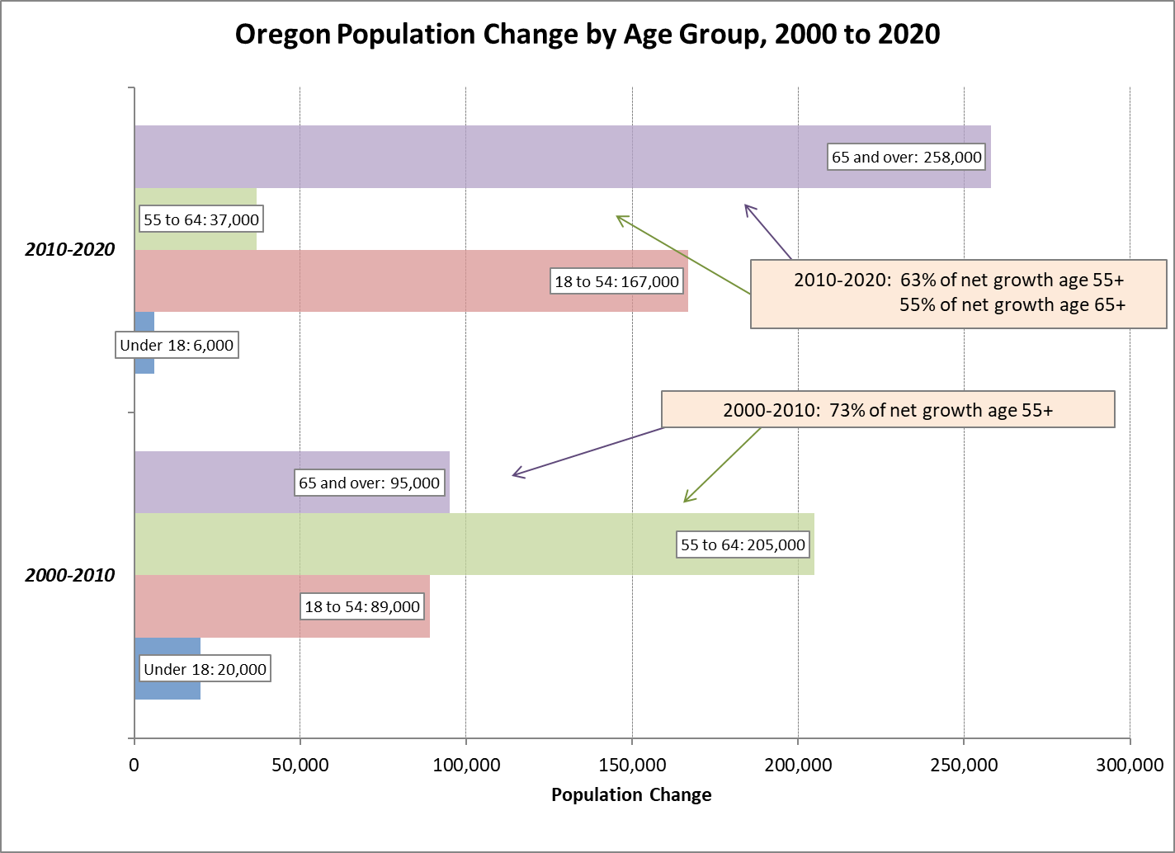
Source: U.S. Census Bureau, Decennial Census, 2000-2010 and 2020 Oregon Office of Economic Analysis (2019Q1) Population Forecasts.
Notes:
Although most of the net population growth in the current decade is in older age groups, growth in the age 18 to 54 group exceeds that of the 2000s.

Slide 29
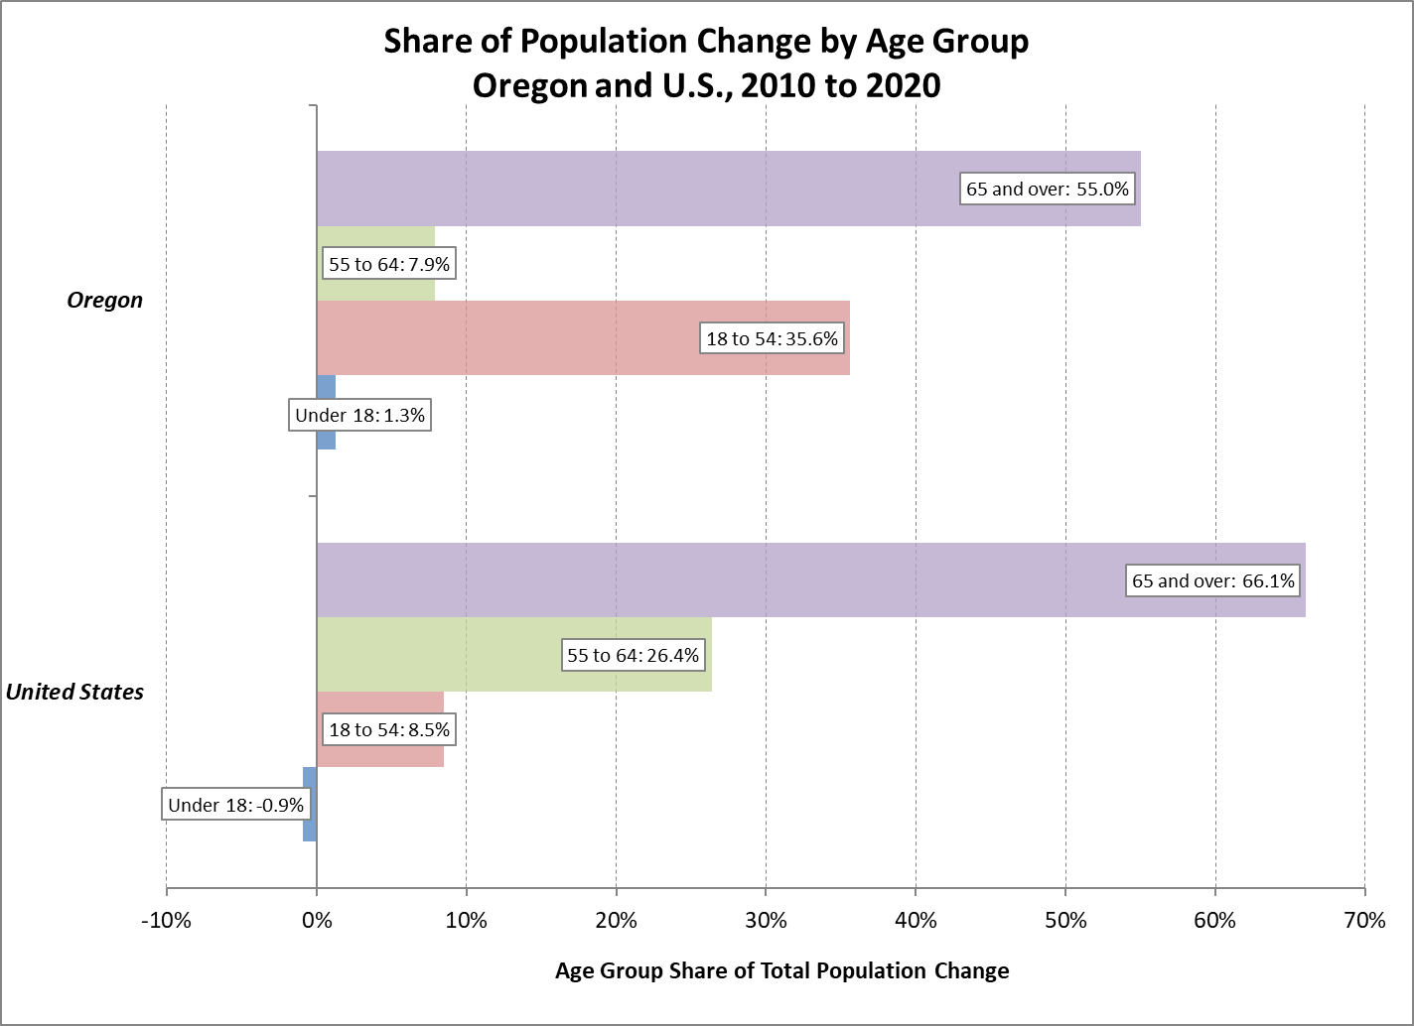
Source: U.S. Census Bureau, 2017 National Population Projections and 2020 Oregon Office of Economic Analysis (2019Q1) Population Forecasts.

Slide 30
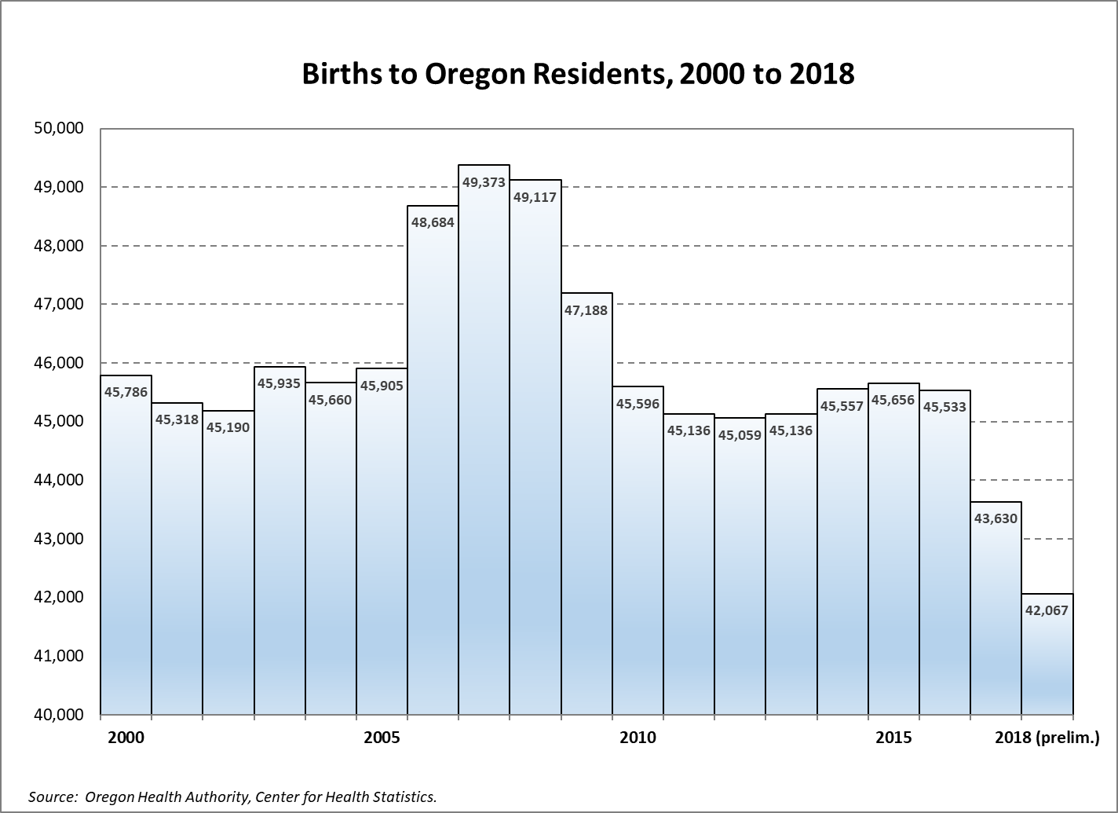
Notes:
There were 43,630 births to Oregon Residents in 2017, the lowest total since 1995. Figures for 2018 are preliminary; they may increase slightly. However, additional decline from 2017 is likely.

Slide 31
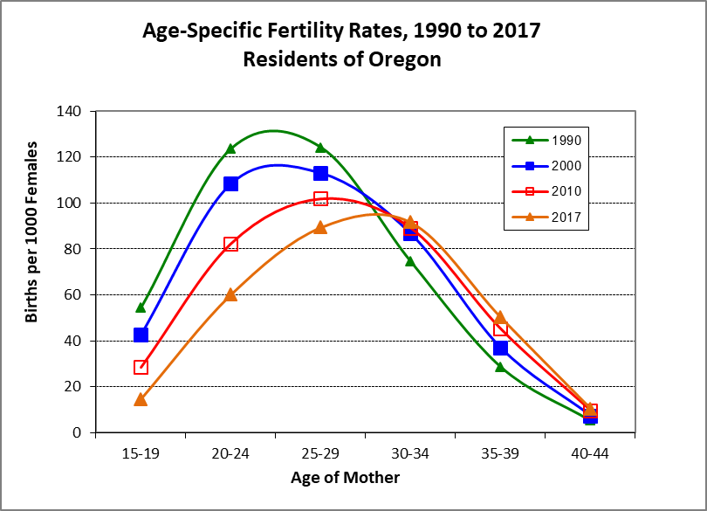
Notes:
Why have births fallen in spite of a growing state population? Aging is part of the reason but the biggest factor is declining birth rates for younger women.
Age-specific fertility rates have fallen sharply for women under age 30, and increased slightly for women age 30 and older.

Slide 32
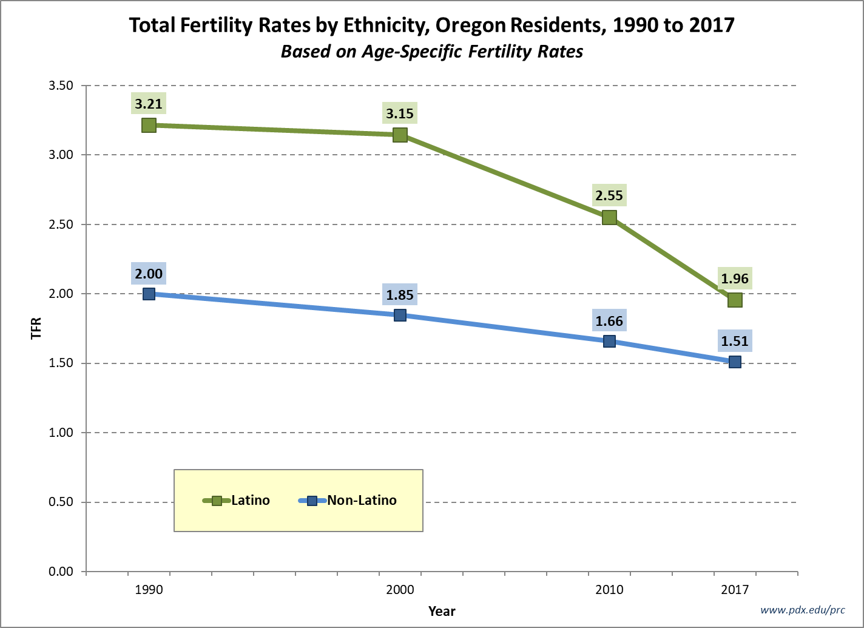

Slide 33
